Slide 1
Understanding basic Electric Circuits

Slide 2
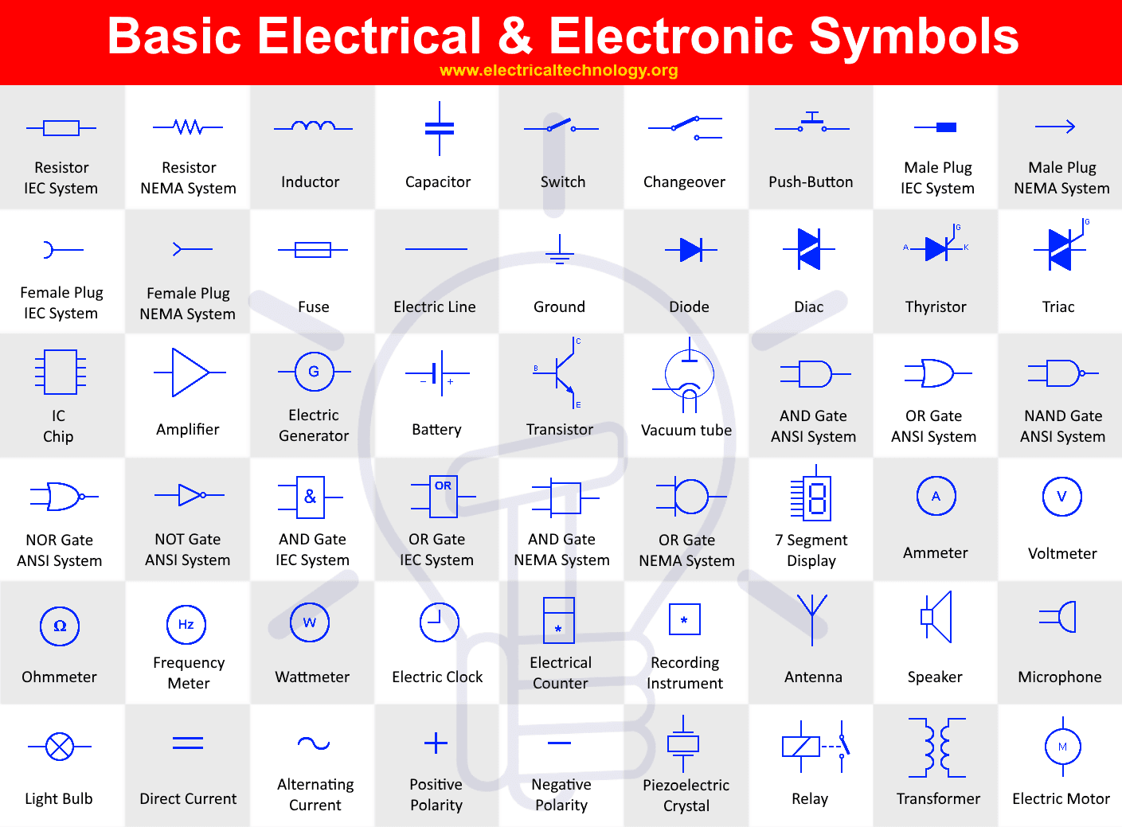
Electrical symbols

Slide 3
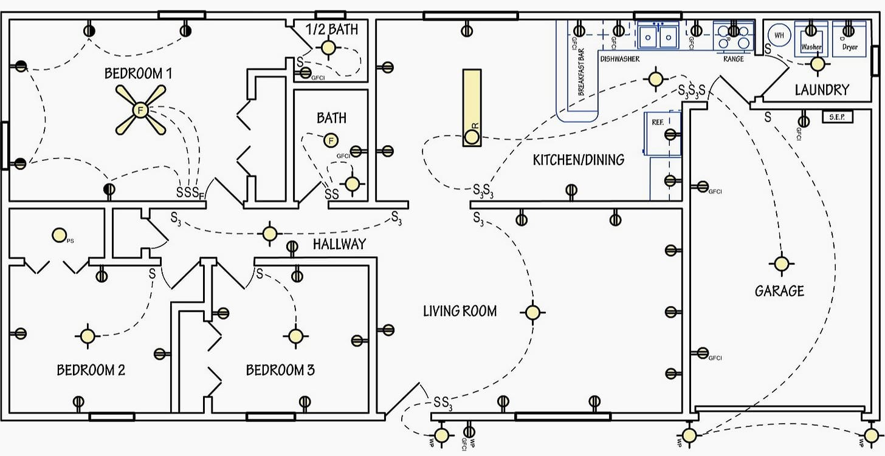
Blue Print

Slide 4
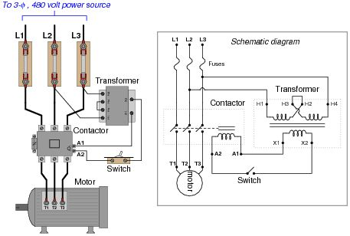
Control circuits

Slide 5
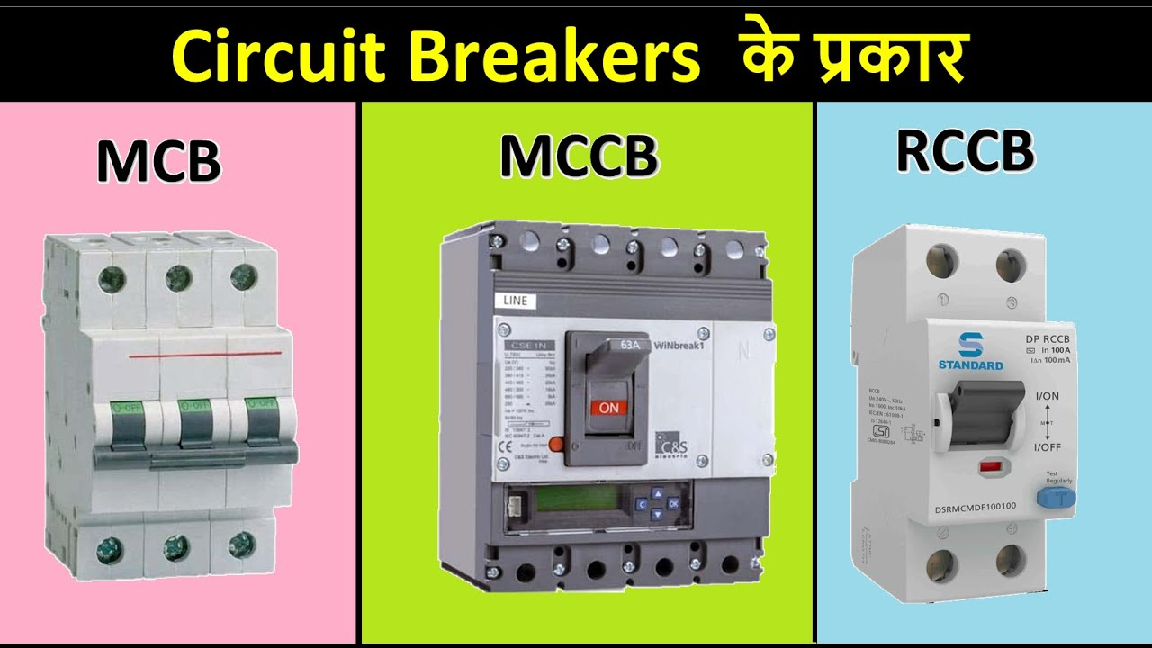
Circuit breakers

Slide 6
MCB (Miniature Circuit Breaker)
MCB is a better safety and control switch. Unlike a fuse, an MCB operates as an automatic switch and opens in the event of excessive current flowing through the circuit. Once the circuit returns to normal, it can be reclosed without any manual replacement.

Slide 7
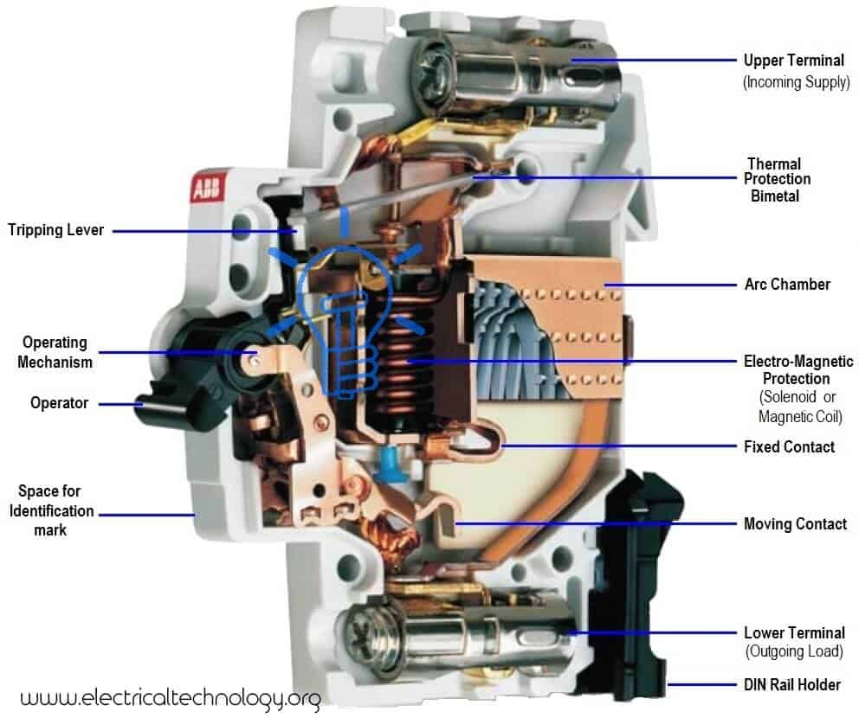
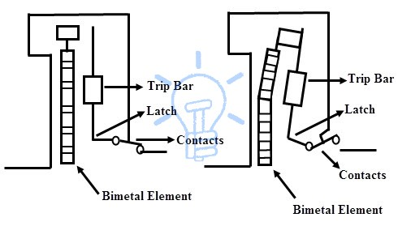
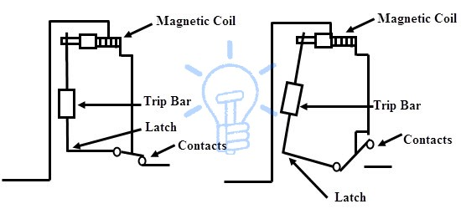
MCB working
The switching system consists of a fixed and a moving contact to which incoming and outgoing wires are connected. As the contacts are separated in the event of an overload / short circuits, an electric arc is formed. An arc runner forces the arc produced between the main contacts.
Operating mechanism:
The magnetic tripping :It consists of a magnetic system that has a spring loaded dashpot . A current carrying coil moves the slug against spring that moves the trip lever.
In case of short circuits/overloads, strong magnetic field of the coils attracts the armature of the trip.
The thermal tripping: The arrangement consists of a bimetallic strip around which a heater coil is wound to create heat depending on the flow of current. The deflection of a bimetallic strip activates the tripping mechanism in case of certain overload conditions.

Slide 8
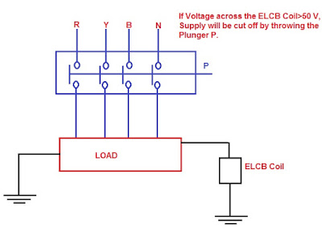
Earth leakage circuit breaker
An Earth-leakage circuit breaker (ELCB) prevents shock through high Earth impedance. It identifies tiny voltages on top of the electrical equipment with a metal enclosure and breaks the circuit when hazardous voltage is identified..
Working
An electrical circuit breaker is a latching relay. The mains supply of buildings that are connected through its switching contacts so that circuit breaker disconnects the power once earth leakage is identified. By using this, the fault current can be detected from line to the ground wire in the fitting it guards. If large voltage comes out across the sense coil of the circuit breaker, it shuts down the power

